Slide 1
DATA LINK LAYER
UNIT II:
Data link layer: Data Link Layer Design Issues, Error Detection, and Correction, Elementary Data Link Control Protocols, Sliding Window Protocols, HDLC, PPP

Slide 2
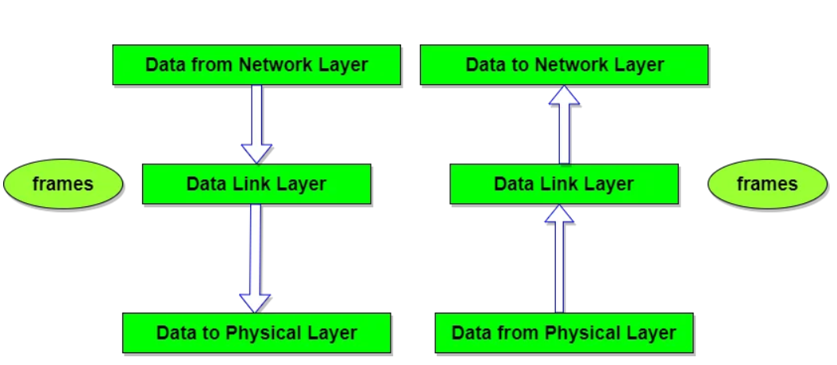
Overview of DLL
Data Link Layer is the second layer of the seven-layer OSI model that is responsible for simply ensuring and confirming that the bits and bytes received are similar to the bits and bytes being transmitted.
Specific responsibilities of the data link layer include framing, addressing, flow control, error control, and media access control.
It forms frames from the packets that are received from network layer and gives them to the physical layer.

Slide 3
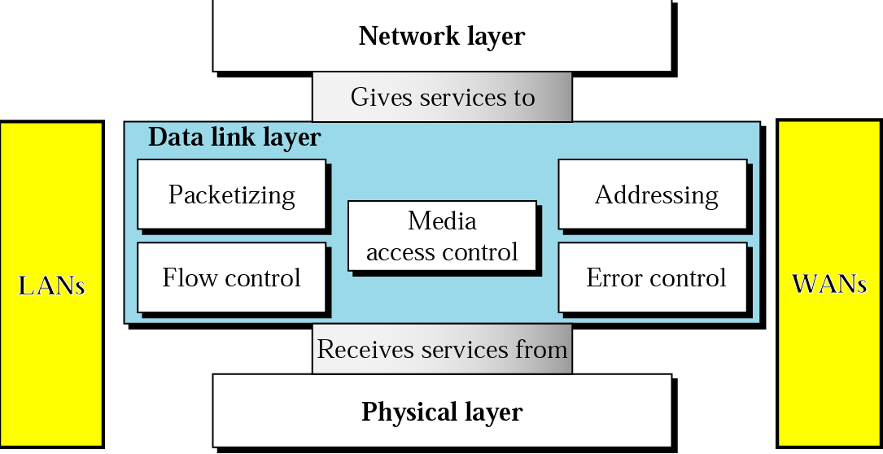

Slide 4
DLL Design Issues
◆ Services Provided to the Network Layer
The network layer wants to be able to send packets to its neighbors without worrying about the details of getting it there in one piece.
❖ Framing
Group the physical layer bit stream into units called frames. Frames are nothing more than "packets" or "messages". By convention, we use the term "frames" when discussing DLL.
 Error Control
Sender checksums the frame and transmits checksum together with data. Receiver re-computes the checksum and compares it with the received value.
 Flow Control
Prevent a fast sender from overwhelming a slower receiver.

Slide 5
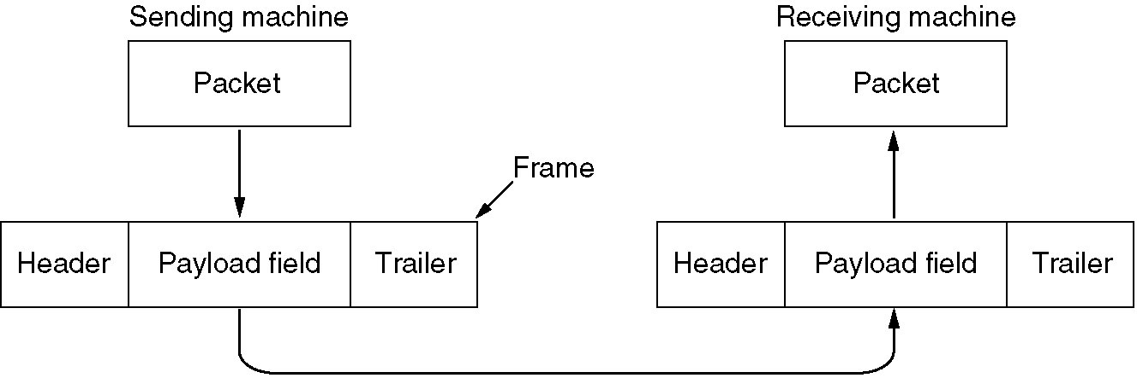
Data Link Layer Design Issues
Providing a well-defined service interface to the network layer.
For this, the data link layer takes the packets it gets from the network layer and encapsulates them into frames for transmission. Each frame contains a frame header, a payload field for holding the packet, and a frame trailer

Slide 6
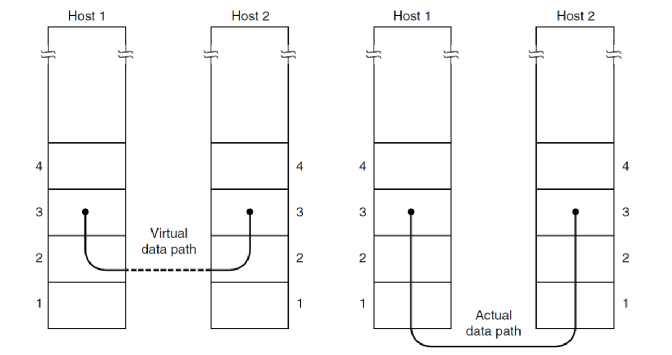
Services provided to the network layer
The function of the data link layer is to provide services to the network layer. The principal service is transferring data from the network layer on the source machine to the network layer on the destination machine.

Slide 7
The data link layer can be designed to offer various services. The actual services offered can vary from system to system. Three reasonable possibilities that are commonly provided are
Unacknowledged Connectionless service
Acknowledged Connectionless service
Acknowledged Connection-Oriented service

Slide 8
Unacknowledged Connectionless service
Unacknowledged connectionless service consists of having the source machine send independent frames to the destination machine without having the destination machine acknowledge them.
No logical connection is established beforehand or released afterward. If a frame is lost due to noise on the line, no attempt is made to detect the loss or recover from it in the data link layer.
This class of service is appropriate when the error rate is very low so that recovery is left to higher layers.
Most LANs use unacknowledged connectionless service in the data link layer.

Slide 9
Acknowledged Connectionless service
When this service is offered, there are still no logical connections used, but each frame sent is individually acknowledged.
In this way, the sender knows whether a frame has arrived correctly. If it has not arrived within a specified time interval, it can be sent again.
Adding Ack in the DLL rather than in the Network Layer is just an optimization and not a requirement. If individual frames are acknowledged and retransmitted, entire packets get through much faster.
This service is useful over unreliable channels, such as wireless systems. 802.11 (WiFi) is a good example of this class of service.
If acknowledgments in acknowledged connectionless service are lost then the frame must be sent and received several times, wasting bandwidth.

Slide 10
Acknowledged Connection-Oriented service
The source and destination machines establish a connection before any data are transferred.
Each frame sent over the connection is numbered, and the data link layer guarantees that each frame sent is indeed received.
Furthermore, it guarantees that each frame is received exactly once and that all frames are received in the right order.
When connection-oriented service is used, transfers go through three distinct phases.
In the first phase, the connection is established by having both sides initialize variables and counters needed to keep track of which frames have been received and which ones have not.
In the second phase, one or more frames are actually transmitted.
In the third and final phase, the connection is released, freeing up the variables, buffers, and other resources used to maintain the connection

Slide 11
Services to network layer
Unacknowledged connectionless service
Acknowledged connectionless service
Acknowledged connection-oriented service
Connectionless service Connection-oriented service
Unacknowledged
Independent frames
Error rate should be low
Recovery left to higher layers
Used on LANs
Acknowledged
No connection
Acknowledgement for each packet
Resending
Ack is optimization; also transport layer can handle errors
Acknowledged
Each frame received exactly once
All frames received in the right order
3 distinct phases:
Establishment of connection
Data transfer
Release of connection

Slide 12
Framing
DLL translates the physical layer's raw bit stream into discrete units (messages) called frames.
How can frame be transmitted so the receiver can detect frame boundaries? That is, how can the receiver recognize the start and end of a frame?
◆ Byte count
❖ Flag byte with Byte Stuffing
⬥ Flag bits with bit stuffing.
 Physical layer coding violations

Slide 13
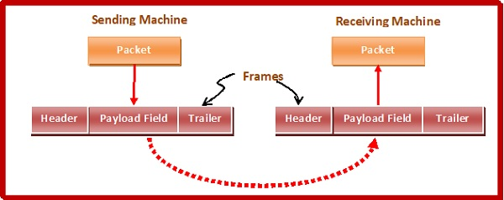
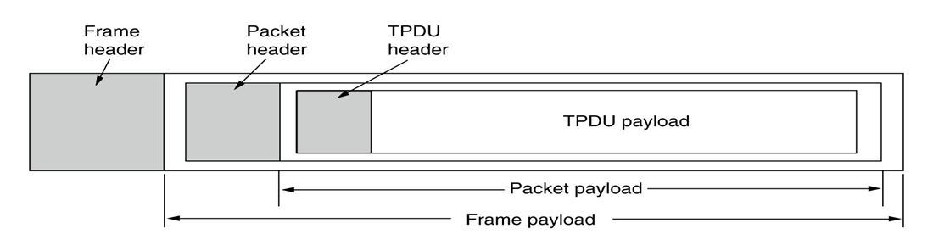

Slide 14
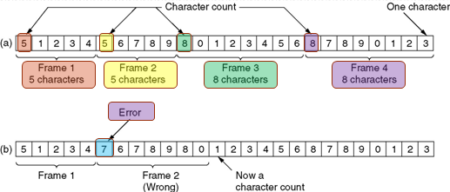
Framing – Byte count
The first framing method uses a field in the header to specify the number of bytes in the frame. When the data link layer at the destination sees the character count, it knows how many characters follow and hence where the end of the frame is.
The trouble with this algorithm is that the count can be garbled by a transmission error.

Slide 15
Byte count

Slide 16
Framing – byte stuffing
Each frame starts and ends with a Flag byte. Often the same flag byte is used as both the starting and ending delimiter
DLE STX (Data-Link Escape, Start of TeXt) at the beginning of a frame, and the sequence DLE ETX (End of TeXt) at the end of the frame.
Two consecutive flag bytes indicate the end of one frame and the start of the next. Thus, if the receiver ever loses synchronization it can just search for two flag bytes to find the end of the current frame and the start of the next frame.
Problem 1: what happens if a flag byte occurs in the data?
Sender’s data link layer inserts a special escape byte (ESC) just before each ‘‘accidental’’ flag byte in the data. Thus, a framing flag byte can be distinguished from one in the data by the absence or presence of an escape byte before it.
The data link layer on the receiving end removes the escape bytes before giving the data to the network layer. This technique is called byte stuffing.

Slide 17
Framing – byte stuffing
Problem 2: What happens if an escape byte occurs in the middle of the data?
Stuffed with an escape byte i.e. Sender’s data link layer inserts a special escape byte (ESC) just before each ‘‘accidental” ESC byte in the data.
The data link layer on the receiving end removes the escape bytes before giving the data to the network layer.
Used in PPP (Point-to-Point Protocol), which is used to carry packets over communications links
Byte stuffing uses 8-bit bytes

Slide 18
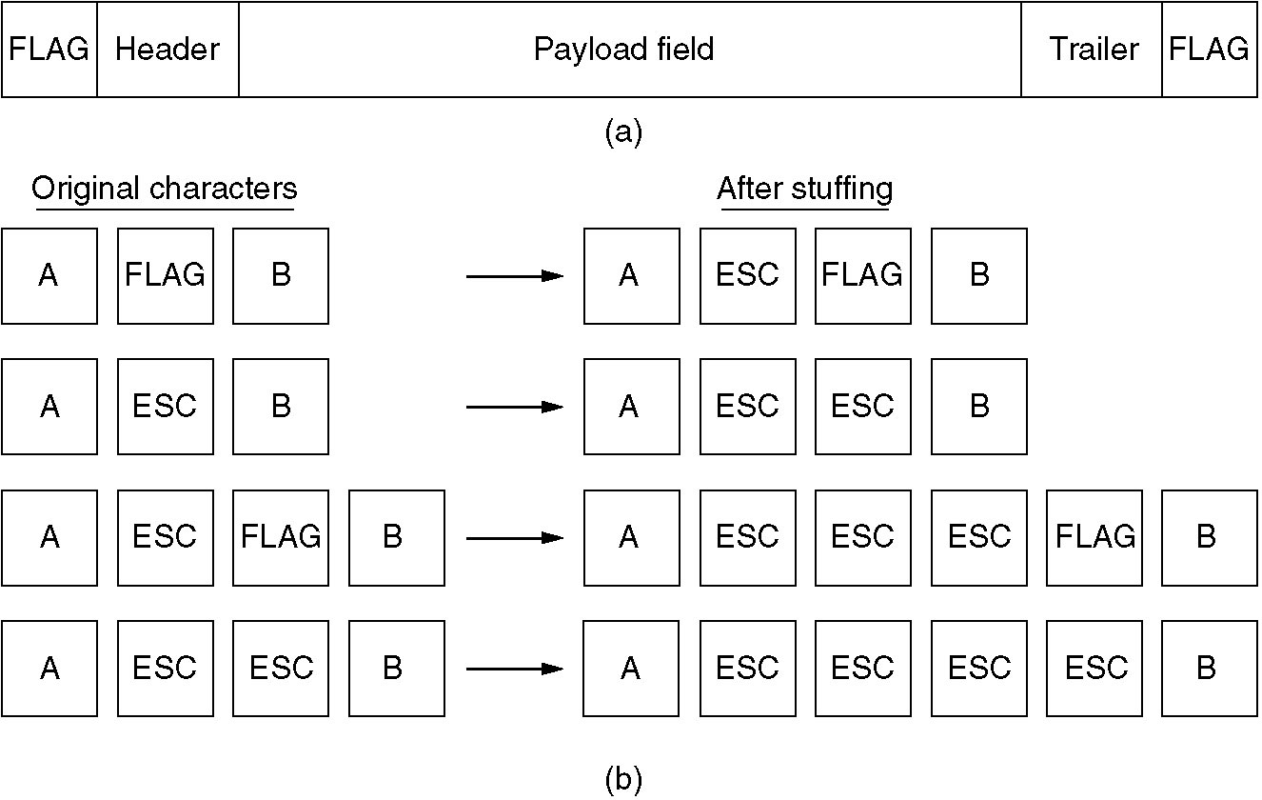
FRAMING – Character Byte Stuffing

Slide 19
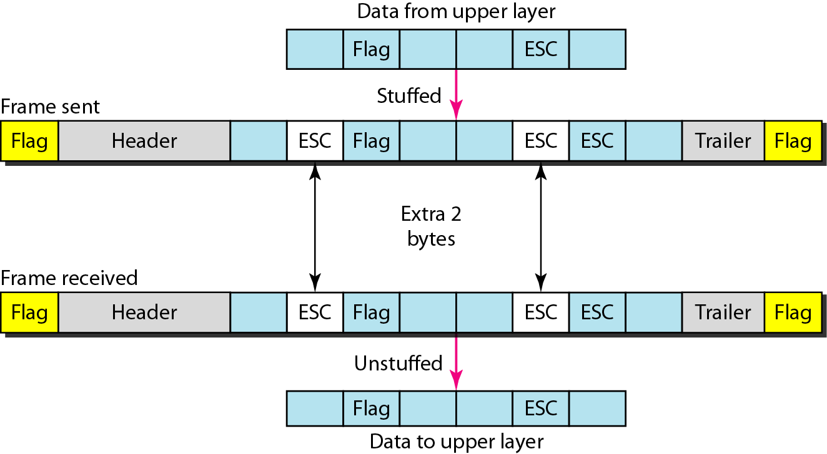
Byte stuffing and unstuffing

Slide 20
Framing – bit stuffing
Framing can also be done at the bit level, so frames can contain an arbitrary number of bits made up of units of any size.
Each frame begins and ends with a special bit pattern, 01111110 (in fact, a flag byte) or 0x7E in hexadecimal
Whenever the sender's data link layer encounters five consecutive 1s in the data, it automatically stuffs a 0 bit into the outgoing bit stream.
When the receiver sees five consecutive incoming 1 bits, followed by a 0 bit, it automatically destuffs (i.e., deletes) the 0 bit

Slide 22
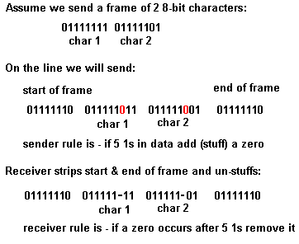
Bit stuffing example

Slide 23
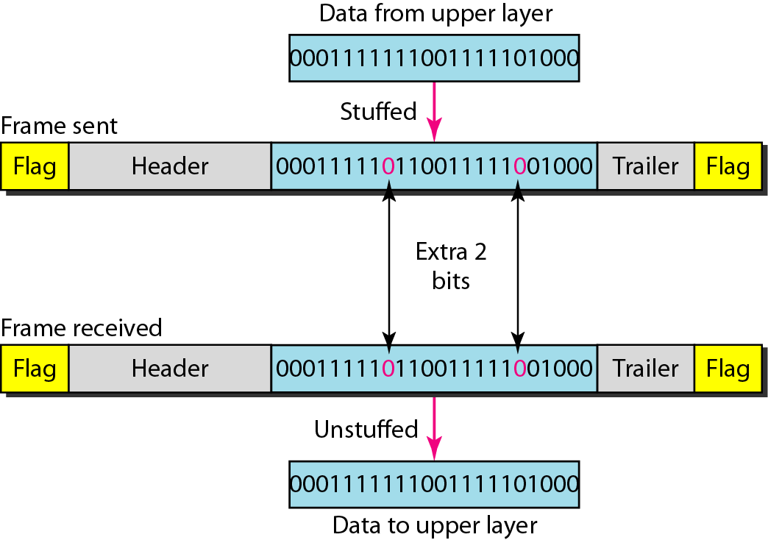
Bit stuffing and unstuffing

Slide 24
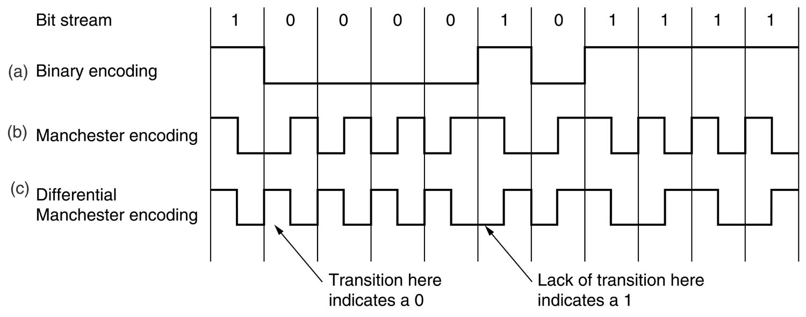
Physical layer coding violations
This Framing Method is used only in those networks in which Encoding on the Physical Medium contains some redundancy.
The scheme uses some reserved signals to indicate the start and end of frames.

Slide 25
Framing
Types of Framing
Framing can be of two types, fixed sized framing and variable sized framing.
Fixed-sized Framing
Here the size of the frame is fixed and so the frame length acts as delimiter of the frame. Consequently, it does not require additional boundary bits to identify the start and end of the frame.
Example − ATM cells.
Variable – Sized Framing
Here, the size of each frame to be transmitted may be different. So additional mechanisms are kept to mark the end of one frame and the beginning of the next frame.

Slide 26
Flow Control
Flow control deals with the speed of the sender to match that of the receiver.
Two Approaches:
feedback-based flow control, the receiver sends back information to the sender giving it permission to send more data or at least telling the sender how the receiver is doing
rate-based flow control, the protocol has a built-in mechanism that limits the rate at which senders may transmit data, without using feedback from the receiver.
Various Flow Control schemes uses a common protocol that contains well-defined rules about when a sender may transmit the next frame. These rules often prohibit frames from being sent until the receiver has granted permission.

Slide 27
Error control
Error control is concerned with insuring that all frames are eventually delivered (possibly in order) to a destination or not.
Acknowledgments: Typically, reliable delivery is achieved using the “acknowledgments with retransmission" paradigm, whereby the receiver returns a special acknowledgment (ACK) frame to the sender indicating the correct receipt of a frame.
In some systems, the receiver also returns a negative acknowledgment (NACK) for incorrectly-received frames. This is nothing more than a hint to the sender so that it can retransmit a frame.
Timers: What happens if an ACK or NACK is lost during transmission?
Retransmission timers are used to resend frames that don't produce an ACK. When sending a frame, schedule a timer to expire at some time after the ACK should have been returned. If the timer goes off, then the transmitter retransmits the frame.
Sequence Numbers: Retransmissions introduce the possibility of duplicate frames. To suppress duplicates, add sequence numbers to each frame so that a receiver can distinguish between new frames and old copies.

